Slide 1

A Crash Course on Statistical Inference

Slide 2
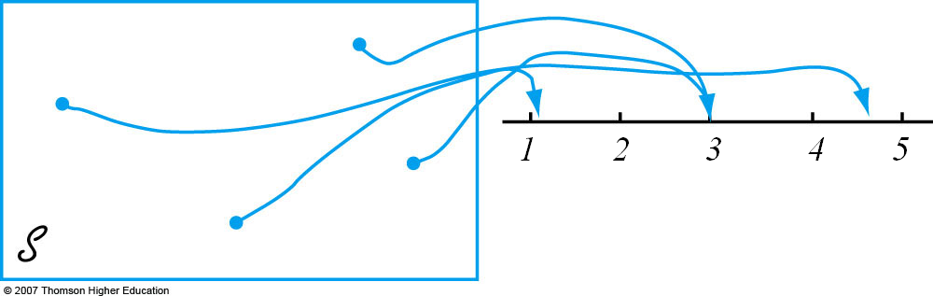
Random Variables
A random variable is a variable whose possible values are outcomes of a random phenomenon and occur according to a frequency distribution
Tons
Example of random variables: total weight of baggage for a sample of 25 airline passengers
“A variable because different numerical values are possible and random because the observed value depends on which the of the possible experimental outcomes results.”
Different samples of passengers will have variable baggage weights, with possible outcomes going from zero to many tons, and each potential outcome (or range of potential outcomes) having a certain probability associated with it
Notes:
In general, each outcome of an experiment can be associated with a number by specifying a rule of association.
Difference between variable and random variable: http://apcentral.collegeboard.com/apc/members/courses/teachers_corner/36972.html

Slide 3
Example
You have two gas stations across the street from each other, each one with three pumps.
Let X = total number of pumps in use at the two stations
Possible values of X at any given time range between 0 and 6
Let Y = the difference between the number of pumps in use at station 1 and the number in use at station 2
Possible values of Y at any given time range between -3 and 3
Let U = maximum of the numbers of pumps in use at the two stations
Possible values of U at any given time range between ___ and ___.
Assume we carry out the experiment and get event s = (# cars at gas station 1, # cars at gas station 2) = (2,3). That is, there are 2 cars at the first gas station and 3 cars at the second gas station. So, when s = (2,3),
X(s) = X((2,3)) = x = 2 + 3 = 5
Y(s) = Y((2,3)) = y = 2 – 3 = -1
U(s) = U((2,3)) = u = max(2,3) = 3
Notation: X(s) = x means that x is the value associated with the outcome s by the random variable X.

Slide 4
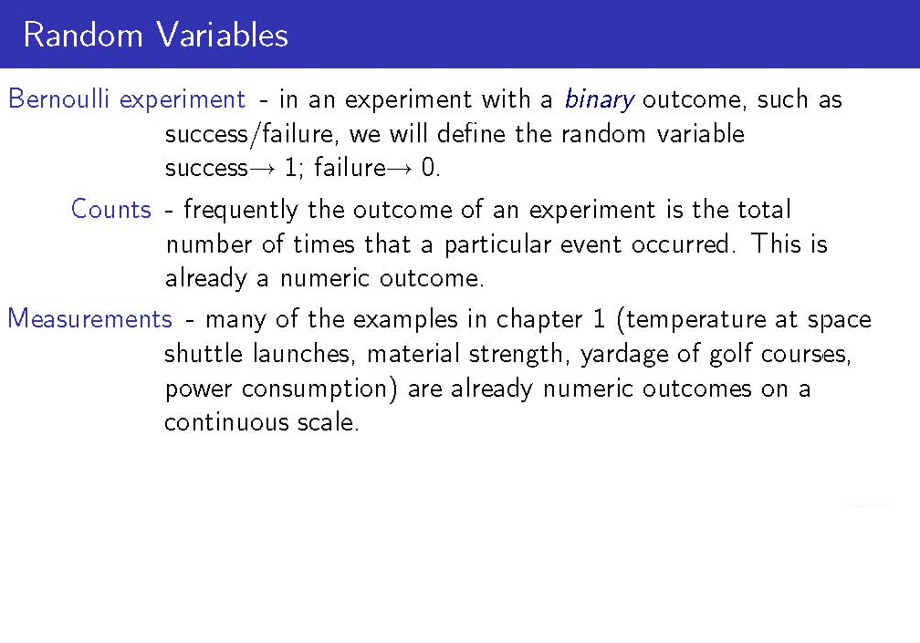
Notes:
Bernoulli: Coin toss
Count: # of cars in a parking lot at any given time
Measurement: life of a light bulb

Slide 5
Continuous vs. Discrete RVs
A discrete random variable is an rv whose possible values either constitute a finite set, or else can be listed in a countable infinite sequence (in which there is a first element, a second element, etc.)
E.g., Number of cars at a gas station; Outcome of a coin toss; Number of coin tosses until the first “tails” outcome; years (rounded to nearest integer); etc.
A random variable is continuous if both of the following apply:
Within the limits of the variable ranges, any value is possible
E.g.: A person randomly sampled from the population of the US might weigh between 2 and 1200 pounds (with any possible value between 2 and 1200 pounds being possible – 180.42390847203 pounds, 230.432123 lbs, etc.)
Probability of any specific value is zero
However, the probability of any set or interval of values within the limits of variable’s range will be positive. For instance, we shouldn’t think of the probability of a randomly selected person weighing exactly 100 pounds. We may, however, think of the probability of a randomly selected person weighing between 99.999999999 and 100.0000000001 pounds. (This interval is within the possible range of 2 and 1000 pounds).

Slide 6
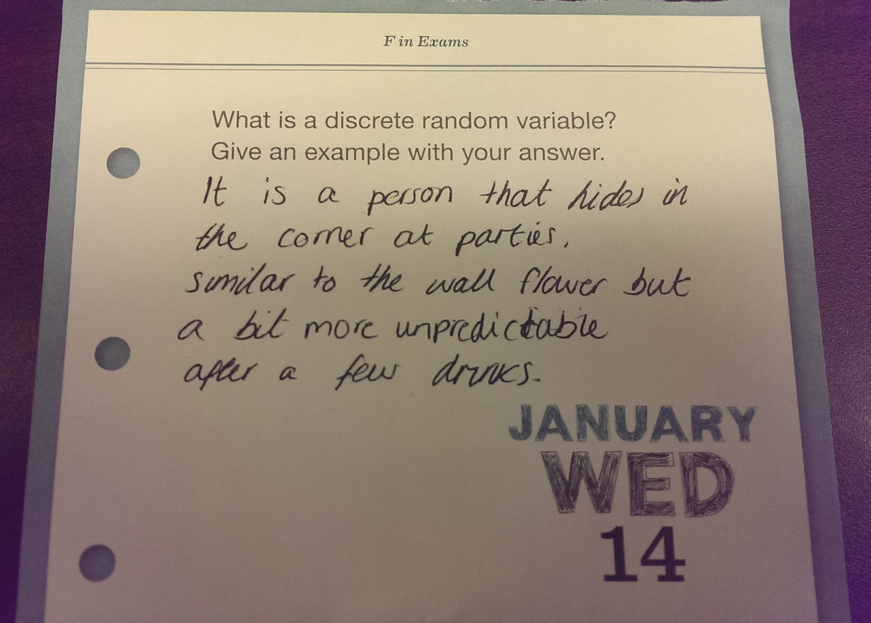

Slide 7
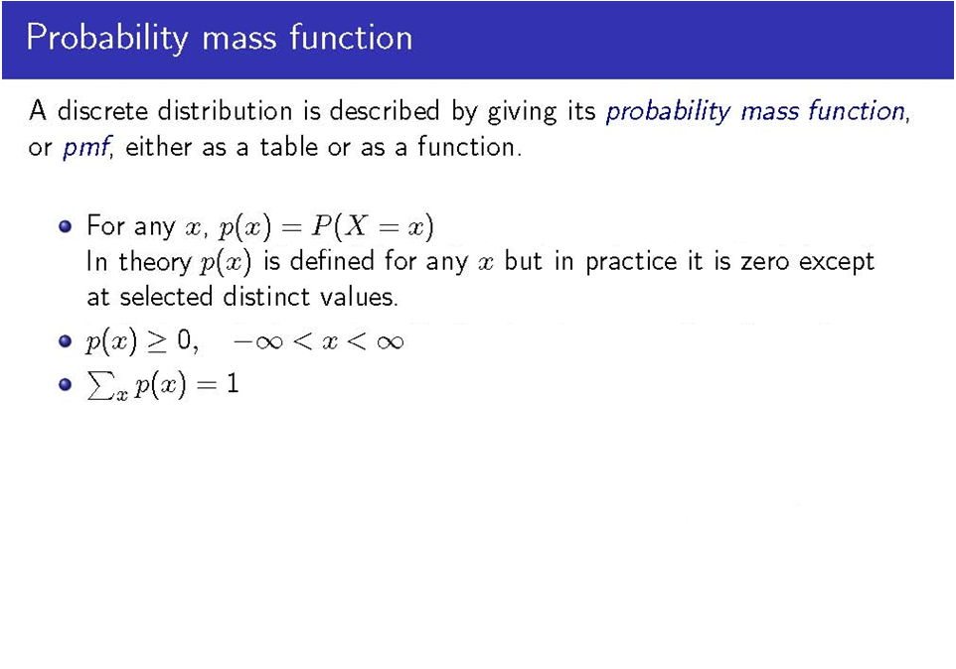
Notation
In English…
The pmf of a rv X says how the total probability of 1 is distributed among (i.e., allocated to) various possible X values (denoted by x). For every possible value of x of the rv X, the pmf specifies the probability of observing that value when the experiment is performed.
If the value of x can never come up in an experiment, then the probability of x is 0.
The pmf is also known as the probability distribution

Slide 8
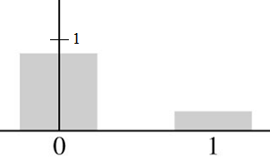
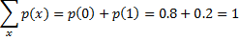
Example of a PMF
Suppose we go to a university bookstore during the first week of classes and observe whether the next person buying a computer buys a laptop or a desktop model. Let rv X=1 if the customer purchases a laptop computer, and X=0 if the customer purchases a desktop computer. If 20% of all purchasers during that week select a laptop, the pmf for X is:
p(0) = P(X=0) = P(next customer purchases a desktop model) = 0.8
p(1) = P(X=1) = P(next customer purchases a laptop model) = 0.2
p(x) = P(X=x) = 0 for x ≠ 0 or 1
Probability Histogram

Slide 9
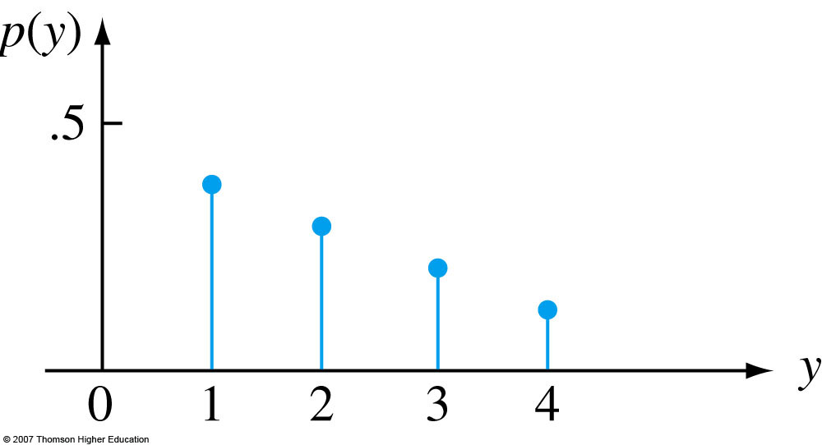
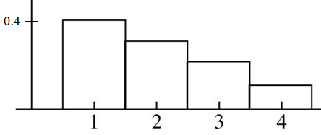
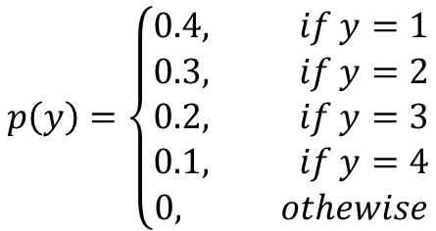
Another Example…
Assume that for a certain species, the probability of a single birth is 0.4, the probability of twin births is 0.3, the probability of triplet birth is 0.2, and the probability of quadruplet birth is 0.1. Let the random variable ‘number of births’ be denoted by Y, and assume for the sake of example that P(Y> 4) = 0.
The pmf of Y is…
$$p\left(y\right)=\left\{\begin{aligned}0.4, if y=1 \\ 0.3, if y=2 \\ 0.2, if y=3 \\ 0.1, if y=4 \\ 0, othewise\end{aligned}\right.$$
Line graph Probability Histogram

Slide 10
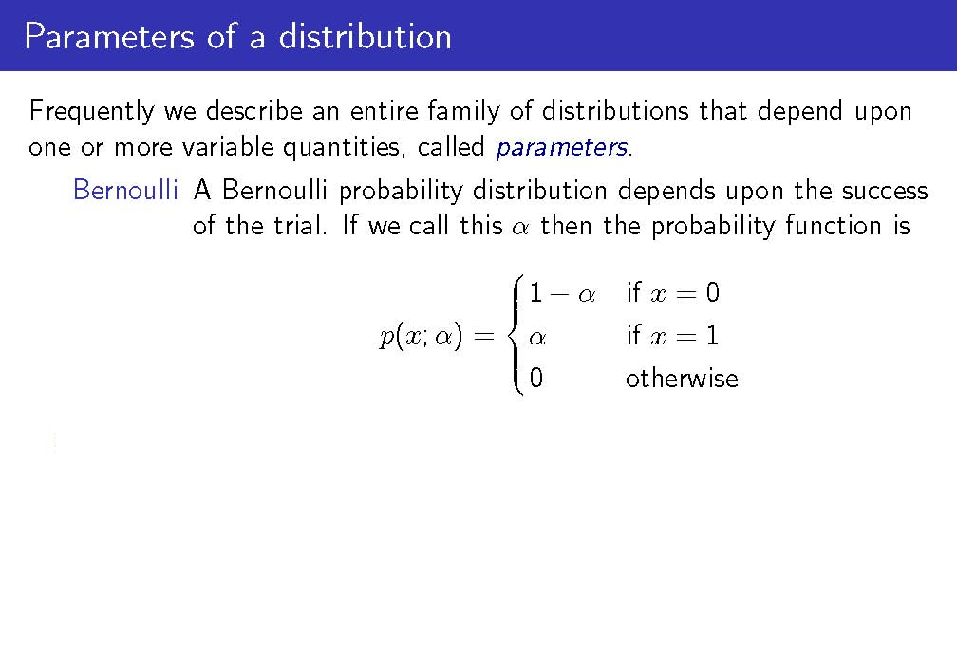
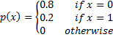
Failure
Success
Recall earlier example on desktop and laptop computers; α = 0.2

Slide 11
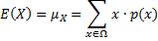
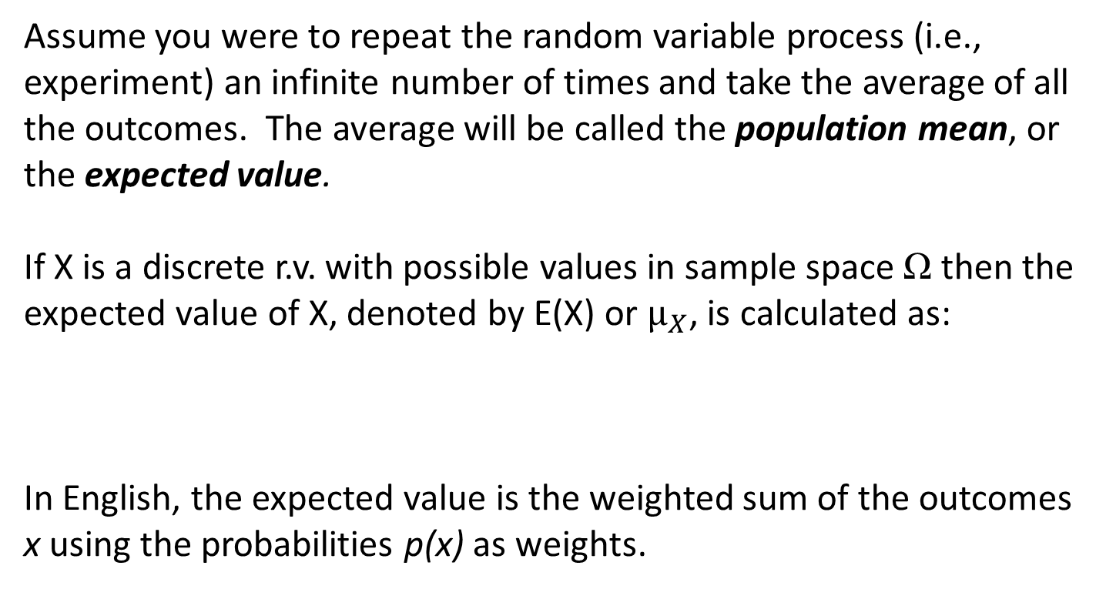
Expected Values
Assume you were to repeat the random variable process (i.e., experiment) an infinite number of times and take the average of all the outcomes. The average will be called the population mean, or the expected value.
If X is a discrete r.v. with possible values in sample space Ω then the expected value of X, denoted by E(X) or $μ_{X}$, is calculated as:
In English, the expected value is the weighted sum of the outcomes x using the probabilities p(x) as weights.

Slide 12
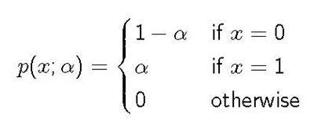
Expected Value of a Bernoulli rv
Q: What is the expected value of the rv X in our desktop/ laptop example?
A: Here, α is 0.2, so E(X) = µx = 0.2.
E(X) is the population average, or the mean of X in the population, or the expected value of X.
You can also think about this using the definition on the previous slide. Expected value: repeat the experiment an infinite # of times and average all outcomes. Here, in 80% of the cases, you will get X=0. In 20% of the cases, you will get X=1. So, 0.8*0 +0.2*1 = 0.2

Slide 13
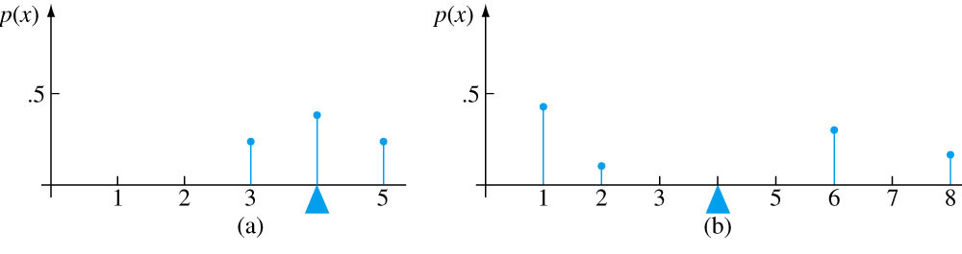
More on Expected Value
The expected value is where you would place the fulcrum to
‘balance’ the axis. For both the distributions below, E(X) = µ
= 4. However, the second distribution has greater variability
or dispersion than the first. We will use the variance of X to
assess the amount of variability in the distribution of X, just
as we used s² to measure variability in a sample.

Slide 14


Slide 15
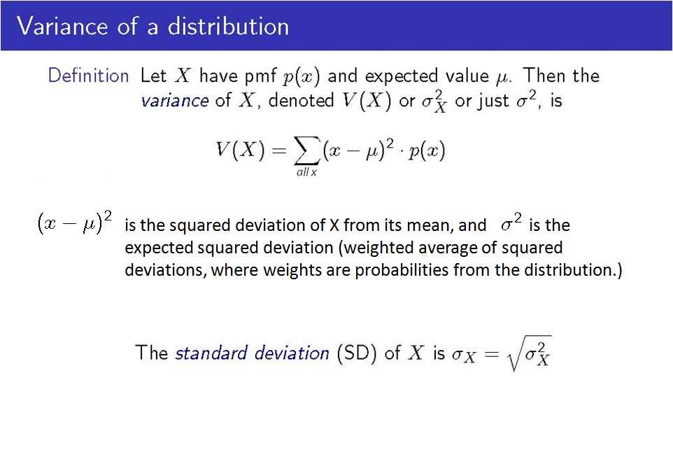

Slide 16
Variance of a Bernoulli RV
Recall that for a Bernoulli rv, the mean is simply α
The variance V(X) of a Bernoulli rv is α (1 – α)
In the laptop/desktop example, where α is 0.2, the variance is 0.2*(1-0.2) = 0.2*0.8 = 0.16

Slide 17
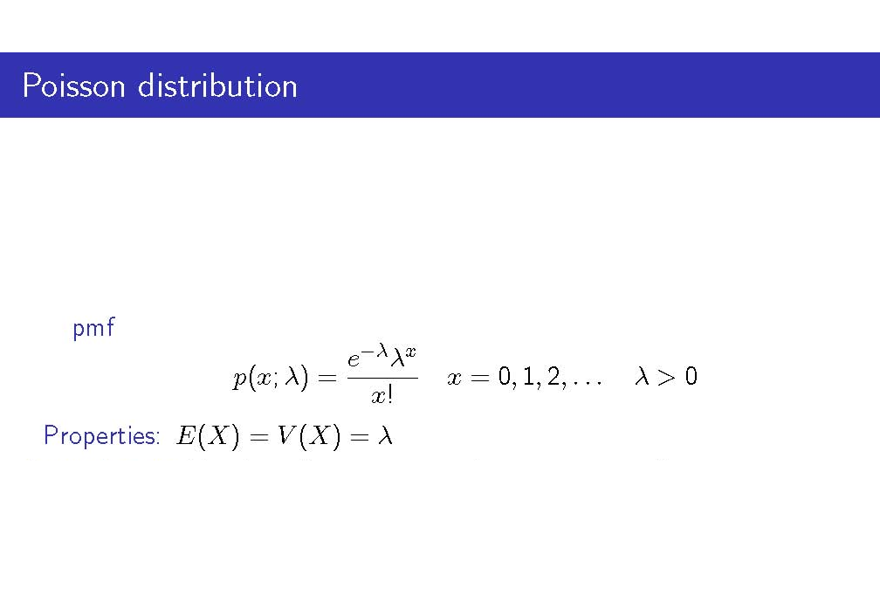
The Bernoulli distribution was derived by starting with an experiment consisting of trials or draws. There is no simple experiment on which the Poisson distribution is based.
(See https://www.youtube.com/watch?v=65n_v92JZeE for proof)
The value of λ is often a rate per unit time or rate per unit area.
You will see the Poisson Distribution when you do point pattern analysis.
Notes:
E(X) = V(X) = λ: Equidispersion

Slide 18
Example
Let X denote the number of deer sighted by a Yellowstone park ranger on a given day. Suppose that X has a Poisson distribution with λ = 4.5. Since λ is the expected value of the Poisson rv, on average, the number of deer seen per day will be 4.5. What is the probability that on a randomly chosen day, the ranger will have seen exactly 5 deer when λ = 4.5?
Answer:
This can be done in Excel. Enter: =POISSON(x, λ,FALSE)’
Here: =POISSON(5,4.5,FALSE) yields 0.1708
This can also be done in R. Enter: ‘dpois(x, λ)’
Here: dpois(5,4.5) yields 0.1708

Slide 19
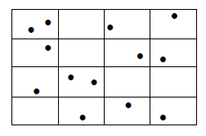
Poisson Process - Example
Suppose that on average, there are 0.81 trees per 1 square meter region R of a [very dense] forest. That is, λ = 0.81 trees per square meter. Then, the probability of seeing exactly one tree in a square meter region is:
In Excel: =POISSON(1,0.81,FALSE)
In R: dpois(1,0.81)
Assume each of these little rectangular regions is R. Area (R)=1

Slide 20
What is a Continuous RV?
A random variable X is continuous if its set of possible values is an entire interval of
numbers – that is for some A < B, any number x between A and B is possible.
Example 1
Assume we make weight measurements of randomly chosen newborns, then r.v. X = weight is a continuous rv. Here, A and B are the minimum and maximum weights of newborns, respectively. Any value x of the rv X is possible as long as it’s between A and B. Assume A= 0.5 lbs and B = 20 lbs. In that case, values 5.89 lbs, 5.89342 lbs, and 5.8934284930238 lbs, and are possible.
General rule:
If the measurement scale of X can be subdivided to any extent desired, then the variable is continuous. E.g., weight can be measured in tons, kilograms, pounds, ounces, grams, milligrams, etc. -> this would be a continuous variable
E.g.: Theoretically, is cost a continuous variable?
In practice, continuous models are often easier to work with than discrete, and do a
good job approximating real-world situations.

Slide 21
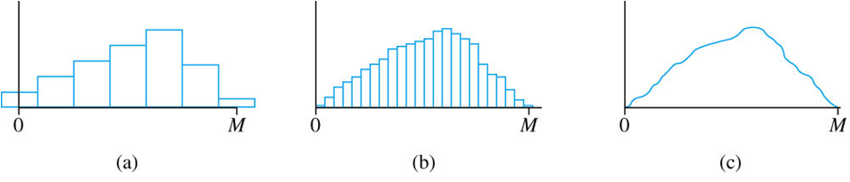
Probability Histograms
Continuous rv X is the weight of a randomly chosen newborn.
Possible values of X are in the interval [0, M].
The graphs below present the probability histogram of weight measured
to the nearest whole kilogram
to the nearest whole pound
to the nearest infinitesimally small unit (i.e., width of the bar approaches 0)
Regardless of the unit of measurement, the total probability of all values x between 0
and M (i.e., the total area of all rectangles) is _____?
The smooth curve in (c) below specifies a continuous probability distribution.
Notes:
What do those histograms mean?

Slide 22
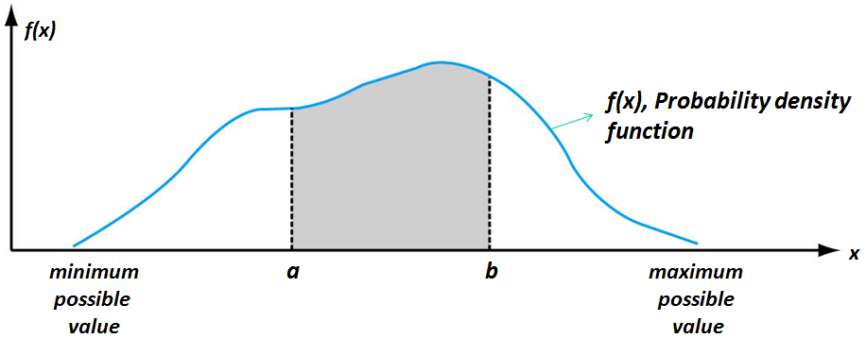
Probability Density Function
Let X be a continuous rv. Then a probability distribution or probability density function
(pdf) of X is a function f(x) such that for any two numbers a and b with a ≤ b, the
P(a ≤ X ≤ b) is the area under the pdf bounded by a and b. In other words, the
probability that X (e.g., depth) is between a and b is simply the area of the shaded
region in the plot below.
P(any single value) = 0
P(min value ≤ x ≤ max value) = 1

Slide 23

PDF

Slide 24
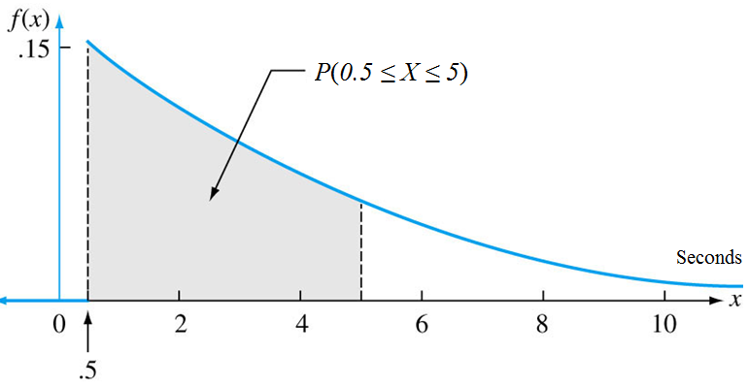
Example
Assume X = time interval (in seconds) between order calls while an infomercial is aired. The pdf of X is as follows. The probability that 0.5 ≤ X ≤ 5 is the shaded area in the graph below. The exact probability can be calculated using calculus (or some computer program) assuming the equation of f(x) is known).

Slide 25
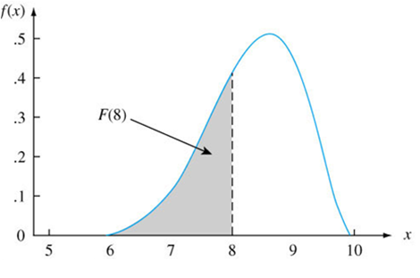
Cumulative Distribution Function
The cumulative distribution function for a continuous random variable X, denoted by F(x), is the probability that the random variable X is at most some value of x.
For example, F(x=8), also written as F(8), is the probability that the r.v. X is at most 8. In the graph above, F(8) is represented by the shaded area.
Notes:
The CDF plots the value of the variable X on the x axis, and the value of the area under the PDF curve to the left of x on the y-axis.

Slide 26
Expected Values of Continuous Random Variables
Recall from the discrete case the definition of an expected value:
Assume you were to repeat the random variable process (i.e., experiment) an
infinite number of times and take the average of all the outcomes. The
average will be called the population mean, or the expected value.
Again, the expected value of a continuous rv X with pdf f(x) is the probability weighted average of the possible values of X.
Let’s go back to our newborn weight example. Assume that you were to pick from the population of newborns many, many times, and record their weight. The expected value of X, which in this case is the rv denoting the weight of newborns, is the long term average weight of all newborns that we pick. Said differently, it is the average of the population of infants.
For discrete rv’s, we might never observe E(X) as an actual value; For continuous rv’s, we might or might not.
Notes:
Example on the board for the long run mean.

Slide 27
Median and Percentiles
The median is the value which splits the area under pdf f(x) in half. That is, 0.5=50% of the area under f(x) is to the left of the median and 0.5=50% of the area under f(x) is to the right of the median.
A percentile is the value of rv X below which a certain percent of observation values fall. So, the 20th percentile is the value of X below which 20% of the observations may be found, 79th percentile is the value of X below which 79% of the observations may be found, etc. What percentile is the median?
Said differently, the value x at the 79th percentile is such that the area under the graph of pdf f(x) to the left of x is equal to 0.79. Or, the probability that we get a value that is at most x is 0.79.
Example for discussion:
When we say that an individual’s SAT score was at the 85th percentile of the population, what do we mean?

Slide 28
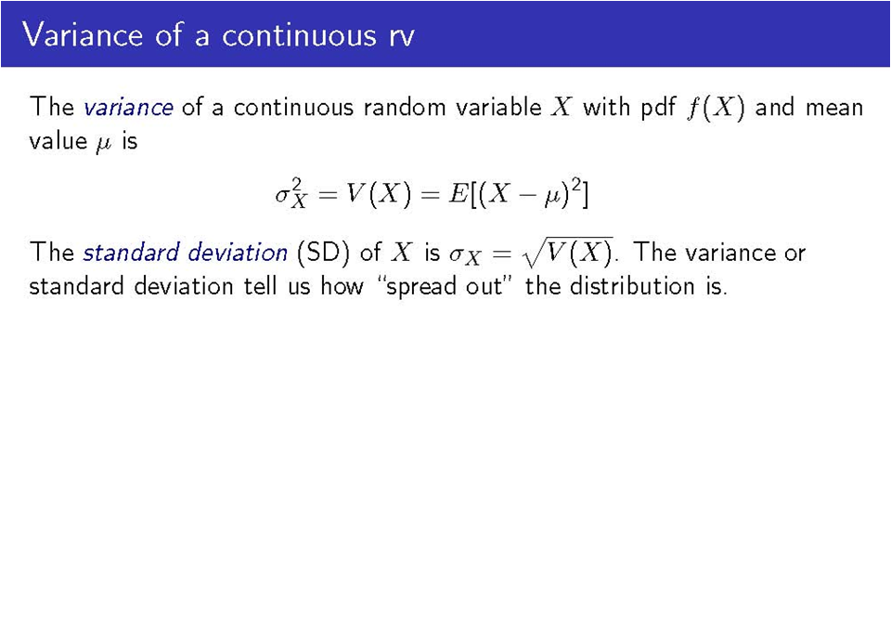
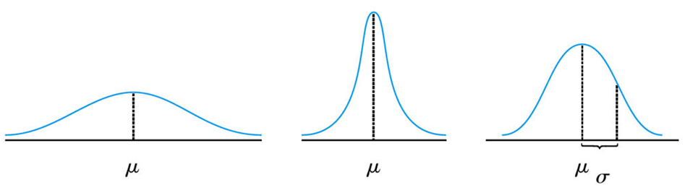
This definition is very similar to the definition in the discrete case.
Also, as with the expected value, we can interpret the variance and standard deviation of an r.v. as the long-run variance and standard deviation of the variable over many independent repetitions of an experiment

Slide 29

Standard Deviation
Source: www.causeweb.org

Slide 30

Standard Deviation

Slide 31

Mean and Standard Deviation

Slide 32
The Normal Distribution
The normal distribution is the most important one in all of probability and statistics
Many numerical populations have distributions that can be fit very closely by an appropriate normal curve. Examples include:
- Height, weight
- Test scores, measurements of intelligence and aptitudes
- Numerous economic indicators
- Measurement errors in experiments (more on that later)
Even when the underlying distribution is discrete, the normal curve often gives an excellent approximation
Even when individual variables are not normally distributed, sums and averages of the variables will (under certain conditions) have a normal distribution.

Slide 33
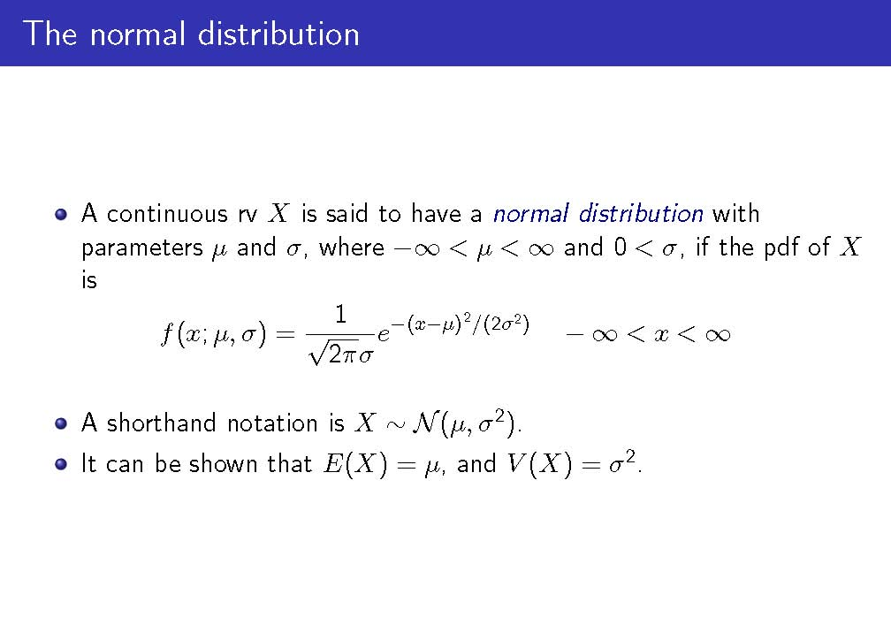
Where did the PDF of the normal distribution come from?
https://www.youtube.com/watch?v=cTyPuZ9-JZ0 (video assumes familiarity with calculus)

Slide 34
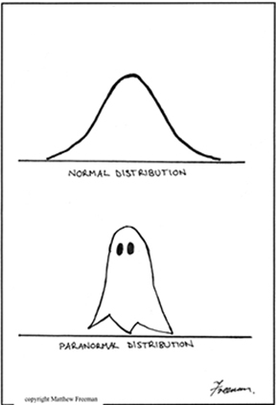
The Normal Distribution
Source: www.causeweb.org

Slide 35
The Standard Normal Distribution
The normal distribution with parameters μ = 0 and σ = 1 is called the standard normal distribution.
A rv with a standard normal distribution is called a standard normal random variable, and is denoted by Z.
The pdf of Z is:
All we’ll say about the cdf of Z is that it is denoted by Φ(z) = P(Z ≤ z), where the Greek letter Φ is pronounced ‘phi’. No formulas ☺
-- E.g., Φ(1.5) = probability that the standard normal random variable will take on a value of at most 1.5 = P(Z ≤ 1.5).
Notes:
Mu is the mean. Sigma is the S.D.

Slide 36
The Standard Normal Distribution
The standard normal distribution doesn’t often serve as a model for a naturally arising population. Instead, it is a reference distribution from which information about other normal distributions can be obtained.
Look at http://www.stat.tamu.edu/~lzhou/stat302/standardnormaltable.pdf. You will see that the table gives you Φ(z) = P(Z ≤ z), which, by definition, is the area under the standard normal pdf to the left of z.
An example will be given on the next slide.

Slide 37
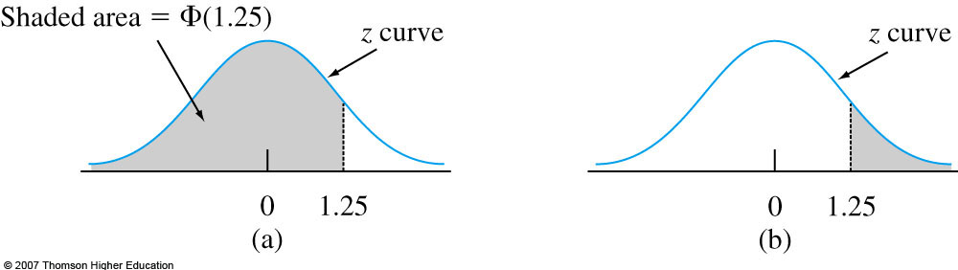
The Standard Normal Curve Areas
Φ (1.25) = P(Z ≤ 1.25)
What percent of the area underneath the standard normal curve is to the left of z=1.25?
Said differently, what is the probability of getting a value of Z that is at most 1.25?

Slide 38
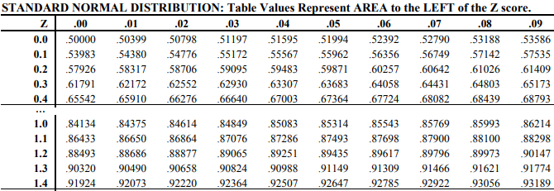
The Standard Normal Curve Areas
The integer and first decimal of z is in the first column.
The second decimal of z is in the first row.
The table below is a section of table A.3 on pp. 668-9 of your book. In the book, z values between -3.49 and 3.49 are in the table.
The area to the left of z=1.25 is 0.89435 R: pnorm(1.25)
The area to the left of z=0.00 is 0.5. R: pnorm(0)
The area to the left of z=0.32 is .62552. That is, 62.552% of the area under the standard normal curve is to the left of z=0.32, and 100%-62.552%=37.448% of the area under the standard normal curve is to the right of z=0.32.
Notes:
http://qwickstep.com/search/standard-normal-table.html

Slide 39
The Standard Normal Curve Areas – More Examples
P(Z ≤ 1.25) Graph (a)
In R: pnorm(1.25) = 0.8944.
I.e., Z=1.25 corresponds to the 89.44th percentile of the standard normal distribution
Said differently, the probability of getting a value of Z that is at most 1.25 is 0.8944.
P(Z>1.25) Graph (b)
Simply subtract the result from above (0.8944) from 1 to get 0.1056.
P(Z ≤ - 1.25)
In R: pnorm(-1.25) = 0.1056. Same answer as above, due to the symmetry of the z-curve.
P(Z = - 1.25) = _____?

Slide 40
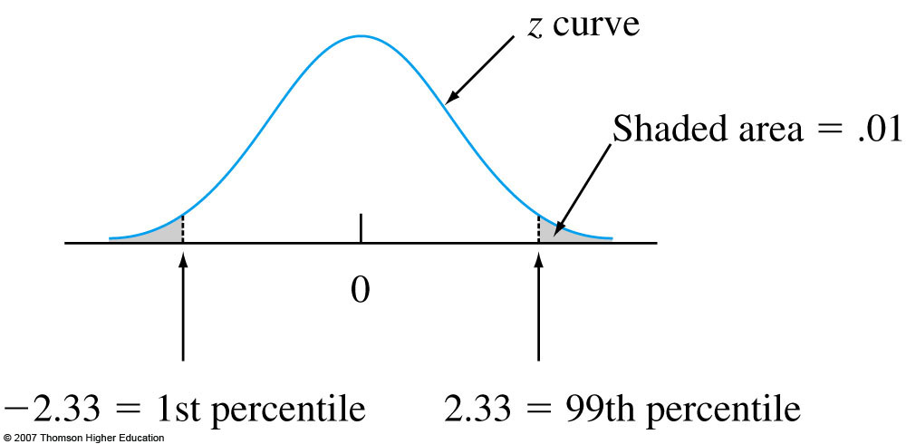
The Standard Normal Curve Areas – More Examples
Now, let’s go the other way. Assume that we want to find the value of z which corresponds to the 99th percentile of the standard normal distribution – that is, we want to find the value of z such that 99% of the area under the z curve is to the left of that value of z.
We can use the tables in the back of any statistics textbook. Or, better yet, we can use the R function qnorm(percentile).
Here, percentile = 0.99. So in R, we can calculate z:
qnorm(0.99) = 2.33 = z.
Since Z is a symmetric rv, what is the value of z which corresponds to the 1st percentile?
Notes:
Ans: -2.33.

Slide 41
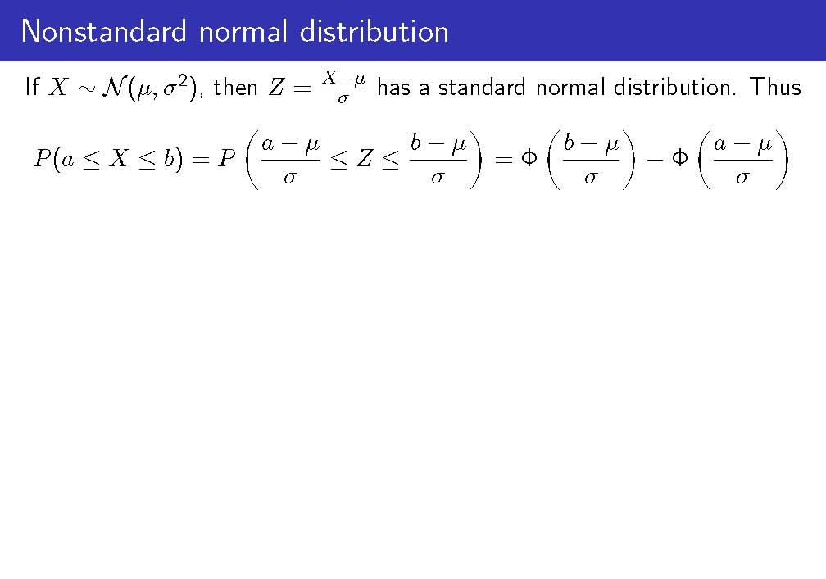
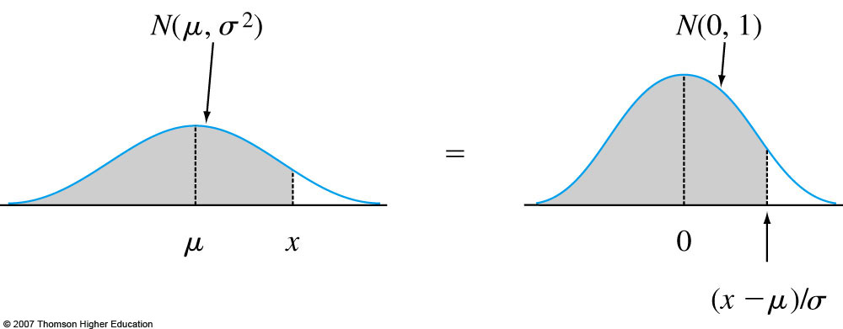
Subtracting μ shifts the mean from μ to 0. Dividing by σ scales the variable so that the standard deviation is 1 rather than σ.

Slide 42
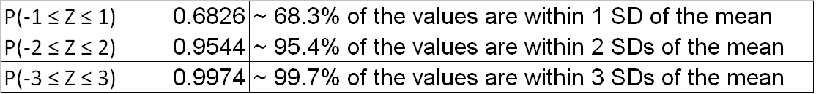
Standardizing and Standard Deviations
Standardizing is essentially calculating the distance (i.e., difference) from the mean value and then reexpressing the distance as some number of standard deviations.
So, if for some rv X, μ = 100 and σ = 15, then X=130 corresponds to z = (130-100)/15=30/15=2.
Said differently, 130 is 2 standard deviations above (or to the right of the mean value).
Likewise X=85 corresponds to z=(85-100)/15=-15/15=-1, so 85 is 1 standard deviation below the mean.
So the standard normal table (link in a previous slide) applies to any normal distribution if we think in terms of the number of standard deviations away from the mean value.
For any normally distributed rv, the probabilities it is within 1, 2, or 3 sd’s of the mean are in the table below:
Probability Value Interpretation

Slide 43
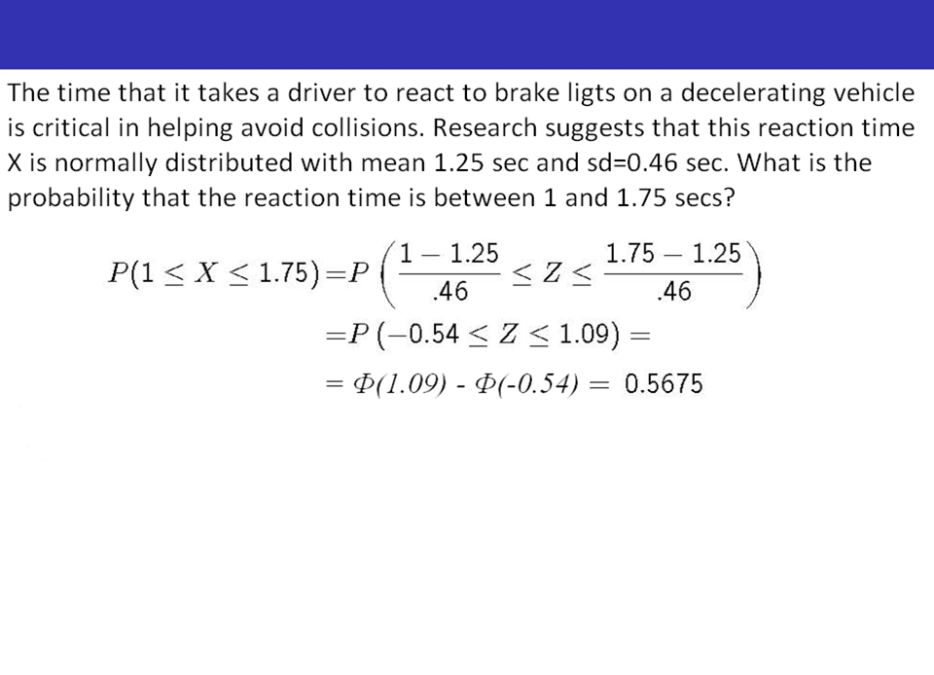
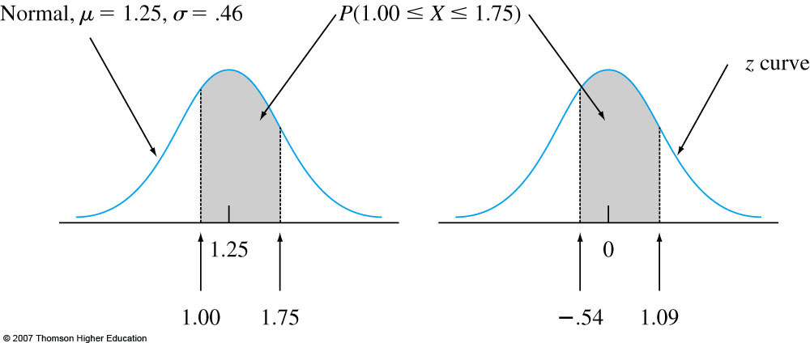
Example
In R: pnorm(1.09) - pnorm(-.54)

Slide 44

Introduction to Statistics and Their Distributions
Recall the diagram below from earlier. We will soon be shifting from probability into statistical inference, where we want to use information from the sample to make statements about the population, and not the other way around.
That is, think about how things often operate in practice:
Research studies typically select a sample to make a conclusion about a population
Political polls typically random dial to obtain data from a sample of the population
Goal: to use sample statistics to make conclusions about the population overall!

Slide 45
What is a Statistic?
A statistic is any quantity the value of which can be calculated from sample data.
Examples: (Assume we have a sample from some rv Y)
Sample mean, Ȳ
Sample SD, S
Sample median, Ỹ
Sum of sample values, T
Assume we want to compare the average SAT scores of a sample of boys (Y1, Y2,…, Yn) and a sample of girls (U1, U2,…,Um). Then the difference between Ȳ and Ū is also a statistic that can be of interest.
We use uppercase letters to denote statistics and lowercase letter to denote the calculated or observed values of statistics. That is, the computed value of the statistic S (sample sd) is denoted by s.

Slide 46
Example
Consider selecting several different random samples from the
same population. Different samples will typically yield different
results (values of statistics)!
For instance, assume we have a population of 10 people who took an exam. Each person’s score (rv Y) is in the table below. Here, µ = 75.9.
Assume we select three random samples of size three.
Bobby | Billy | Jimmy | Jenny | Katy | Sandy | Lenny | Tammy | Larry | Fanny
82 | 43 | 78 | 100 | 84 | 70 | 75 | 67 | 69 | 91
Person |  | Sample 1 |  | Sample 2 |  | Sample 3
Person 1 | Y1 | Billy | 43 | Jimmy | 78 | Jenny | 100
Person 2 | Y2 | Sandy | 70 | Sandy | 70 | Lenny | 75
Person 3 | Y3 | Fanny | 91 | Tammy | 67 | Larry | 69
Sample Mean | Ȳ | 68 |  | 71.67 |  | 81.33

Slide 47
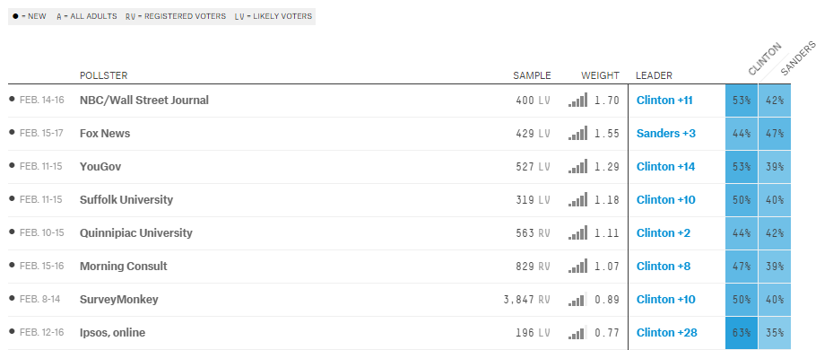
Shouldn’t Be a Surprise…

Slide 48
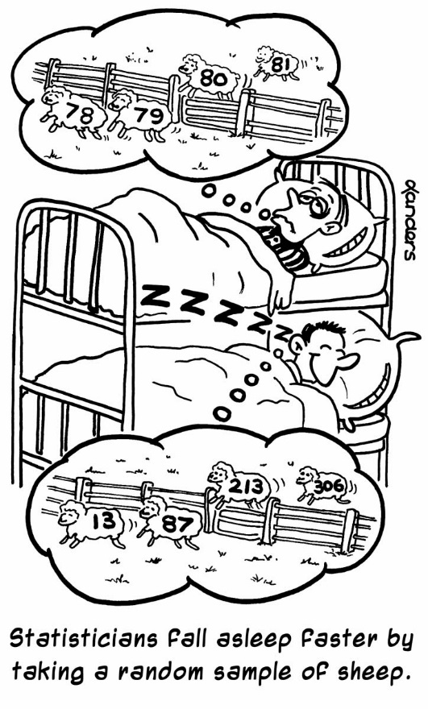

Slide 49
Statistics are Random Variables with Probability Distributions
Each random sample will typically yield different observations Y1, Y2 ,…, Yn and therefore, sample mean Ȳ, sample standard deviation S, and any other sample statistics.
A statistic is a random variable since prior to obtaining data, we are not sure what value of any particular statistic will be, and because for each random sample the value of a statistic will typically be different. Thus, Y1, Y2, Y3, Ȳ, S, etc., are all random variables, as there is uncertainty about the value of each of those quantities before we obtain the data.
Because a statistic is an rv, it has a probability distribution, aka sampling distribution, which describes how the statistic varies in value across all samples that might be selected.

Slide 50
The Sampling Distribution of Statistics
The sampling distribution of a statistic depends on:
Population distribution, and whether it is a finite or infinite population
Sample size n
Method of sampling (e.g., with/without replacement).

Slide 51
Simulations
Let’s then draw k random samples, each of size n, from the designated population distribution.
For each sample, we then calculate the value of the statistic and construct a histogram of the k calculated values.
Example on the next slide: We assume we are dealing with random variable Y, which represents a population of 1 million one month-old babies with weights ~ N(µ=8.25 lb; σ=0.75).
From that population, let’s draw k = 500 samples of size n, and for each sample, calculate the sample mean Ȳ. Then, let’s create a histogram of 500 Ȳ values. Let’s do this for n = 5, 10, 20, 30.
That is, let’s draw k=500 samples of n=5 babies, then n=10 babies, then n=20 babies, and then n=30 babies.
Notes:
In practice, we frequently don’t know the population distribution parameters – as in, we’re required to make assumptions about the population parameters from the sample parameters.

Slide 52
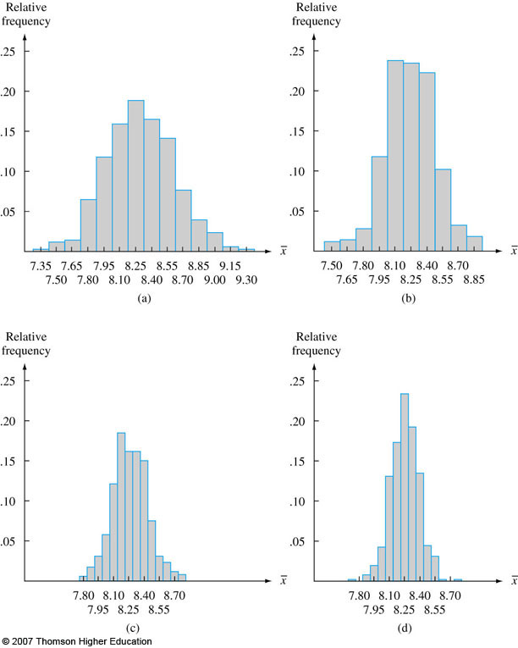
Population ~ N(µ=8.25; σ=0.75)
Everywhere, k=500.
a. n=5; b. n=10;
c. n=20; d. n=30.
Note the shape of the histograms
If k was very large, histogram would look even more ‘normal’.
Each histogram is centered at ~ 8.25 (µ).
The smaller the n, the wider the spread – i.e., the more variation there is, and the greater the effect of outliers.
Ȳ based on a large n is closer to µ than Ȳ based on a small n.

Slide 53
Distribution of the Sample Mean
In reality, we won’t have 500 samples, BUT it’s important to know about the distribution of the sample mean Ȳ because it helps us make conclusions about the population mean µ
Sampling distribution of Ȳ is important for numerous inferential statistics.
Let Y1, Y2, … , Yn be a random sample from a normal distribution with mean µ and
standard deviation σ. Then:
E(Ȳ) = µȲ = µY (µY is often simply written as simply µ)
The sampling distribution of Ȳ is centered at the mean of the population from which the sample has been selected.
σȲ = σY/√n (Correspondingly, V(Ȳ) = σ²/n)
The distribution of Ȳ becomes more concentrated about the mean µ as the sample size n increases. That is, as n goes up, the standard deviation of the sample mean distribution goes down. (See histogram on previous slide)
This should make intuitive sense: the bigger our sample, the closer it is to the population, and the less sampling variability there is – i.e., the less the value of the statistic will vary from sample to sample
We’ll later see that s.d. of the sampling distribution of a statistic (e.g., sample mean), is the standard error.

Slide 54
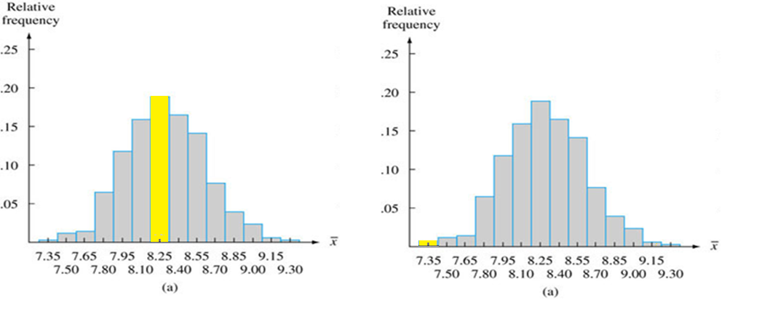
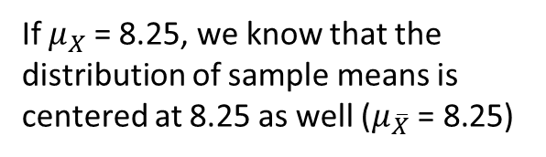
Using the Distribution of Sample Statistics for Inference
If $μ_{X}$ = 8.25, we know that the distribution of sample means is centered at 8.25 as well ($μ_{\overline{X}} \text{= }\text{8.}\text{25}\text{)}$
Knowing that E(Ȳ) = µȲ = µ, we can assess how likely it is that a certain sample with mean ȳ came from the population with mean µ -- a typical problem in statistics
Here, is it likely that a sample where Ȳ = 8.25 came from a population with µ = 8.25?
Is it likely that the sample where Ȳ = 7.35 came from a population with µ = 8.25?
As we will see in the next class, we will assess statements like this with a hypothesis testing procedure.

Slide 55
Central Limit Theorem (CLT)
Let Y1, Y2, … , Yn be a random sample from any* distribution (not necessarily normal). Let the mean of this population be µ and standard deviation be σ. If the sample size is large (>30) then Ȳ will be approximately normal with parameters mean µȲ = µ and sd σȲ = σ/√n.
CLT also says that the sample total T (= Y1 + Y2 + … +Yn) is approximately normal with µT = nµ, and σT = (σ • √n).**
The larger the value for n, the better the approximation.
* If the random sample Y1, Y2, … , Yn is from a normal distribution, then for any n, Ȳ
is normally distributed (with mean = E(Ȳ) = µ and sd of Ȳ = σ/√n)
** Here, we multiply σ by square root of n, as opposed to divide (as for Ȳ ).
http://onlinestatbook.com/stat_sim/sampling_dist/

Slide 56
Reviewing Notation
r.v. Y: Random variable Y
E(Y) = µ_{Y} = Expected value of r.v. Y (i.e., population mean of Y)
V(Y) = σ²_{Y} = Variance of r.v. Y
σ_{Y} = Standard deviation of r.v. Y
Ȳ = Statistic representing the r.v. that is the mean of all the samples drawn from Y
E(Ȳ) = µ_{Ȳ} = Expected value of the sample mean Ȳ
S = Statistic representing the r.v. that is the standard deviation of all the samples drawn from Y
E(S) = µ_{S} = Expected value of the sample standard deviation S
σ_{Ȳ} = Standard deviation of the r.v. Ȳ
σ_{S} = Standard deviation of the r.v. S

Slide 57
Point Estimators and Estimates – Sample Mean
The importance of the sample mean Ȳ springs from its use in drawing conclusions about the population mean µ
Ȳ serves as a point estimator of µ, and the value of Ȳ serves as a point estimate of µ.
In general:
A statistic is an estimator
A value of the statistic is a point estimate
“Point” because the estimate is a single value on the number line (as opposed to an interval, which we’ll look at in a few slides)
Other possible statistics (e.g., sample median Ỹ) may serve as estimators for µ, however, for certain theoretical reasons, Ȳ will be used as the estimator (when we’re dealing with normal rv’s)
Notation: µ̂ = Ȳ means that Ȳ is read as “the point of estimator of µ is the sample mean Ȳ”. Similarly, µ̂=2 is read as “the point estimate of µ is 2”.
Similarly, the importance of the sample sd S springs from its use in drawing conclusions about the population s.d. σ
S serves as a point estimator of σ, and s, the value of S, is a point estimate of σ
Notes:
^ notation for both estimate and estimator.

Slide 58


Slide 59
Standard Error
The standard deviation of any statistic is known as the standard error (se).
The standard error of a statistic is important because it reflects how much sampling fluctuation a statistic will show.
The standard error of the mean is written as σ_{Ȳ}

Slide 60
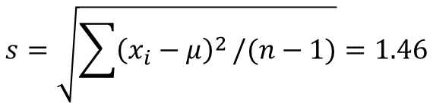
Example
In some of our earlier examples, we had the population and generated samples from it. Typically, in practice, we will have a sample and we will need to use that sample to make some sort of statement about the population.
Example:
Assume we are interested in the parameter µ, which is the true average lifetime (in hours) of calculator batteries of a certain type (rv Y). We have a sample with n=20 observations:
We assume that the distribution of breakdown voltage is normal with mean value µ
If a variable is normally distributed, µ̂ = Ȳ is the best estimator of µ. Here, Ȳ = 27.79. This is the point estimate of population mean µ.
Also, σ̂ = S is the best estimator of σ. Here,
We can also use this estimate, σ̂ = s = 1.46 to
compute the estimated standard error σ̂_{Ȳ} = s_{Ȳ} = s/√n = 1.46/√20 = 0.33.
24.46 | 25.61 | 26.25 | 26.42 | 26.66 | 27.15 | 27.31 | 27.54 | 27.74 | 27.94
27.98 | 28.04 | 28.28 | 28.49 | 28.50 | 28.87 | 29.11 | 29.13 | 29.50 | 30.88
$$s=\sqrt{\sum{{\left(x_{i}−μ\right)}^{2}}/(n−1)}=1.46$$

Slide 61
Summary
We often have to rely on sampling to make conclusions about population.
Each sample selected from a population will typically yield different values of sample statistics (e.g., sample mean, sample s.d., etc).
Each statistic has a sampling distribution, which depends on the population distribution, sample size n, and the method of sampling. The sampling distribution can be derived by probability rules or computer simulations.

Slide 62
Summary (Continued)
The sampling distribution of sample mean Ȳ is centered at the mean of the population from which the sample has been selected.
The distribution of sample mean Ȳ becomes more concentrated about the mean µ as the sample size n increases. That is, as n goes up, the standard deviation of the sample mean distribution (i.e., standard error of the sample mean) goes down.
CLT: Let Y1, Y2, … , Yn be a random sample from any distribution (not necessarily normal). If the sample size is large (>30) then the sample mean Ȳ and sample sum T will be approximately normal.

Slide 63
Summary (Continued)
The importance of the sample mean Ȳ springs from its use in drawing conclusions about the population mean µ. Ȳ serves as a point estimator of µ, and the value of Ȳ serves as a point estimate of µ.
Similarly, the importance of the sample sd S springs from its use in drawing conclusions about the population s.d. σ. S serves as a point estimator of σ, and the value of S is a point estimate of σ.
The standard deviation of any statistic is known as the standard error (se).
Again, the point is that we often don’t know population parameters, and want to estimate them using sample data.

Slide 64
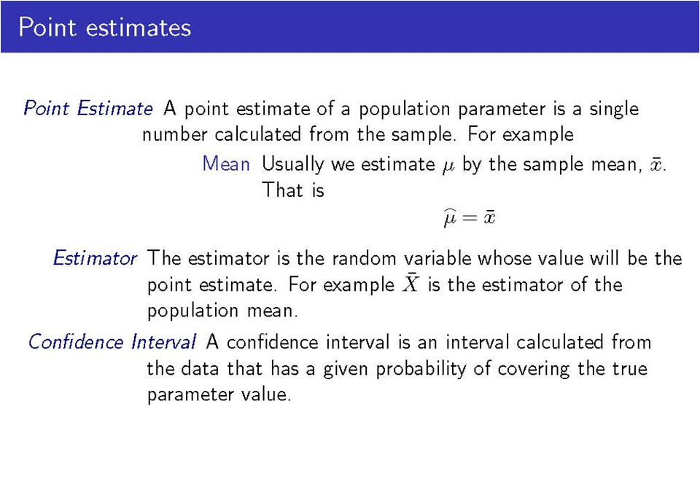

Slide 65
The Idea Behind Confidence Intervals
Population
Mean µ = ?
I am 95% confident that µ is between a and b (e.g., 0.249 and 0.251)
Random Sample
Mean Y̅ =
0.25

Slide 66
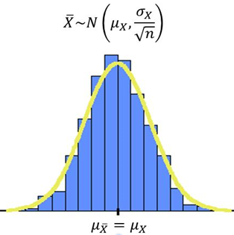
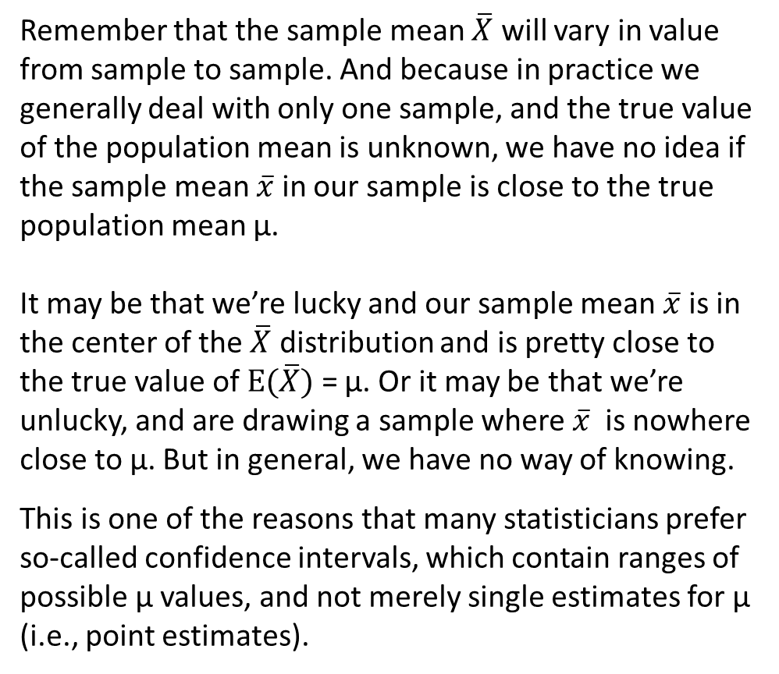
Reviewing
Remember that the sample mean $\overline{X}$ will vary in value from sample to sample. And because in practice we generally deal with only one sample, and the true value of the population mean is unknown, we have no idea if the sample mean $\overline{x}$ in our sample is close to the true population mean µ.
It may be that we’re lucky and our sample mean $\overline{x}$ is in the center of the $\overline{X}$ distribution and is pretty close to the true value of $E(\overline{X})$ = µ. Or it may be that we’re unlucky, and are drawing a sample where $\overline{x}$ is nowhere close to µ. But in general, we have no way of knowing.
This is one of the reasons that many statisticians prefer so-called confidence intervals, which contain ranges of possible µ values, and not merely single estimates for µ (i.e., point estimates).

Slide 67
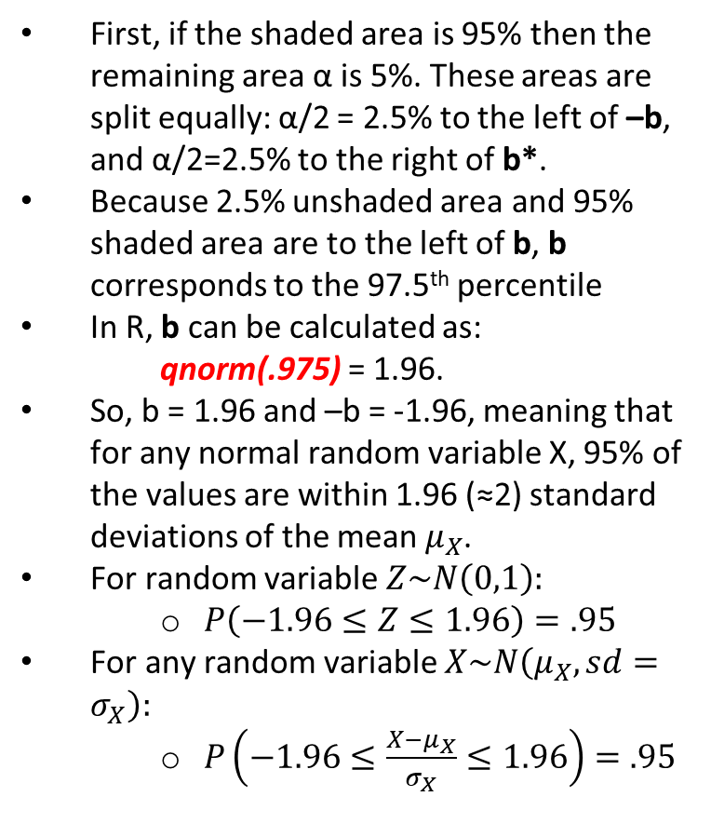
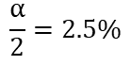
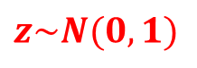
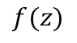
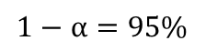
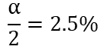
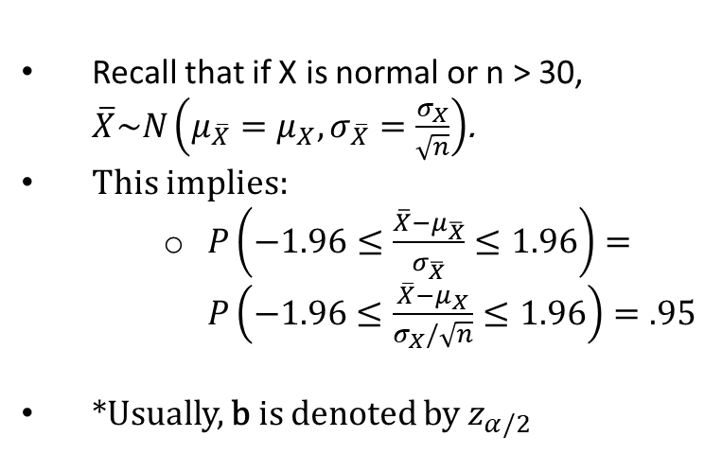
95% CI: Find b such that the shaded area in the graph is 95%
First, if the shaded area is 95% then the remaining area α is 5%. These areas are split equally: α/2 = 2.5% to the left of –b, and α/2=2.5% to the right of b*.
Because 2.5% unshaded area and 95% shaded area are to the left of b, b corresponds to the 97.5th percentile
In R, b can be calculated as:
qnorm(.975) = 1.96.
So, b = 1.96 and –b = -1.96, meaning that for any normal random variable X, 95% of the values are within 1.96 (≈2) standard deviations of the mean $μ_{X}$.
For random variable $Z\sim N\left(0,1\right):$
$P\left(−1.96≤Z≤1.96\right)=.95$
For any random variable $X\sim N\left(μ_{X},sd=σ_{X}\right):$
$P\left(−1.96≤\frac{X−μ_{X}}{σ_{X}}≤1.96\right)=.95$
$$f(z)$$
$$z\sim N(0,1)$$
$$\frac{α}{2}=2.5\%$$
$$\frac{α}{2}=2.5\%$$
$$1−α=95\%$$
z
-b 0 b
Recall that if X is normal or n > 30, $\overline{X}\sim N\left(μ_{\overline{X}}=μ_{X},σ_{\overline{X}}=\frac{σ_{X}}{\sqrt{n}}\right)$.
This implies:
$P\left(−1.96≤\frac{\overline{X}−μ_{\overline{X}}}{σ_{\overline{X}}}≤1.96\right)=P\left(−1.96≤\frac{\overline{X}−μ_{X}}{σ_{X}/\sqrt{n}}≤1.96\right)=.95$
*Usually, b is denoted by $z_{α/2}$

Slide 68


Deriving the 95% Confidence Interval
On the last slide, we saw that that since $\overline{X}\sim N\left(μ_{\overline{X}}=μ_{X},σ_{\overline{X}}=\frac{σ_{X}}{\sqrt{n}}\right)$
$$P\left(−1.96≤\frac{\overline{X}−μ_{\overline{X}}}{σ_{\overline{X}}}≤1.96\right)=P\left(−1.96≤\frac{\overline{X}−μ_{X}}{σ_{X}/\sqrt{n}}≤1.96\right)=.95$$
The formula above simply says that the probability of getting a value that is 1.96 s.d.’s (i.e., $\frac{σ_{X}}{\sqrt{n}}$) away from the mean of $\overline{X}$, $E\left(\overline{X}\right)$, is 95%.
We can rearrange this inequality by multiplying each side by $σ_{X}/\sqrt{n}$, and subtracting $\overline{X}$:
$$P\left(−1.96≤\frac{\overline{X}−μ_{X}}{σ_{X}/\sqrt{n}}≤1.96\right)↔P\left(\overline{X}−\frac{1.96σ_{X}}{\sqrt{n}} ≤ μ_{X} ≤ \overline{X}+\frac{1.96σ_{X}}{\sqrt{n}}\right)=.95$$
The inequality above is the 95% confidence interval for the population mean $μ_{X}$
Shorthand notation: 95% CI for $μ_{X}$ is $\left(\overline{X}±\frac{1.96σ_{X}}{\sqrt{n}}\right)$
Each interval for the population mean $μ_{X}$ is centered around $\overline{X}$
The interval is random because $\overline{X}$ is a random variable, meaning that the lower and upper bounds of the interval will differ from one sample to the next because the value of $\overline{X}$ differs from one sample to the next!
$$\overline{X}−\frac{1.96σ_{X}}{\sqrt{n}} \overline{X} \overline{X}+\frac{1.96σ_{X}}{\sqrt{n}}$$

Slide 69





Constructing the 95% Confidence Interval

Slide 70


Slide 71

Interpreting Confidence Intervals is… HARD!
Example

Slide 72


Interpretation of Confidence Intervals

Slide 73


Slide 74

Confidence Intervals

Slide 75


A note on the standard deviation σ
We’ve seen that the confidence interval for the population mean can be calculated using the formula
$$\overline{X}−z_{α/2}∙\frac{σ_{X}}{\sqrt{n}}<μ<\overline{X}+z_{α/2}∙\frac{σ_{X}}{\sqrt{n}}$$
But this formula includes σ, the population standard deviation. However, one thing we should note is that in practice, if population mean µ is not known then it’s more than likely that the population standard deviation σ is also not known, since the formula for σ implies knowing µ.
In this instance, we simply substitute the sample standard deviation S, the point estimator of the population standard deviation σ in the formula.
Specifically, if $\frac{\overline{X}−μ}{\text{σ}/\sqrt{n}}$ has a standard normal distribution (z), then $\frac{\overline{X}−μ}{S/\sqrt{n}}$ has an approximately standard normal distribution, but only when n ≥ 40 (some say 30).
Note that when n ≥ 40, the distribution of the original variable, $X$, does not matter because of the Central Limit Theorem – that is, $X$ does not have to be normal.
$$σ_{X}=\sqrt{E\left[{(X−μ)}^{2}\right]}$$

Slide 76


Fact: When n is small, sample s.d. s isn’t necessarily close to population s.d. σ. This implies that the distribution of $\frac{\overline{X}−μ}{S/\sqrt{n}}$ will be more spread out than the standard normal distribution.
Notes:
In practice, population standard deviation sigma is generally not known, so we use sample standard deviation S as an estimate of sigma.
When we’re not dealing with large samples (40 or more), S isn’t always close to sigma.
In that case, when X is normal, the quantity X-bar – mu /(S/sqrt(n)) will no longer have a standard normal distribution, instead, it will have a t distribution with n-1 degrees of freedom.
When X̅ is the mean of a random sample of size n from a normal distribution with mean μ, the rv T has a probability distribution called a t distribution with n-1 = df.

Slide 77

T- Distribution has two parameters: α, and degrees of freedom ν
Critical values for selected ν and α can be found at:
http://easycalculation.com/statistics/t-distribution-critical-value-table.php

Slide 78


Slide 79

Illustration
For instance, in the two-tailed scenario when df=10 and α=0.05 (α/2=0.025 is in the right tail and α/2=0.025 is in the left tail), the critical value of t is 2.228.
Note that as df increases, the critical value approaches 1.96, which is what we get from the standard normal distribution!
Full table available at: https://image.slidesharecdn.com/93critvaluetables4th-130205072909-phpapp02/95/93-crit-valuetables4th-2-638.jpg?cb=1360049422
Notes:
As df increases, the critical value approaches 1.96

Slide 80



t Confidence Interval
MANY TESTS THAT WE WILL BE RUNNING (E.G., REGRESSION), WILL REPORT T (AND NOT Z) STATISTICS FOR ALL SAMPLE SIZES
THIS IS BECAUSE T IS MORE APPROPRIATE THAN Z WHEN SAMPLE SIZE N IS SMALL, AND ESSENTIALLY IDENTICAL TO Z WHEN N IS LARGE.
Notes:
ν = Greek Letter ‘Nu’ = n-1

Slide 81
In R
In R, we can get the value of tα/2,ν using the formula: abs(qt(α/2, df))
So, to get tα/2,ν = t0.025, 9, type in:
abs(qt(.025,9)) and you’ll get: 2.262.
abs(qt(.025,49)) and you’ll get: 2.0095.
Compare with: abs(qnorm(0.025)) = 1.96
If you know the t-value and the df and want to get the α, then we can use the pt function
So, typing in:
1-pt(2.262,9) will yield α/2 = 0.025
1-pt(2.0095,49) will yield α/2 = 0.025
(1-pt(2.262,9))*2 will yield α = 0.05
(1-pt(2.0095,49))*2 will yield α = 0.05

Slide 82

T-Distribution

Slide 83
Hypothesis Testing
A statistical hypothesis is a claim about the values of one or more population parameters.
Example: The FDA claims a drug can treat an infection in 8 days. However, the pharmaceutical company that makes the drug says that this is inaccurate and the drug actually treats the infection in less than 8 days.
Hypothesis A: µ = 8 days. That is, the true average number of days it takes the drug to treat the infection is 8 days.
-- Here, there is no – or null – change from what the FDA claims (in other examples, no change from current theory)
-- This is called the null hypothesis, and is denoted by H0 H-naught
Hypothesis B: µ < 8 days. That is, the true average number of days it takes the drug to treat the infection is less than 8 days.
-- This is the company’s claim, different from current claim by the FDA
-- This is the alternative hypothesis, denoted by Ha or H1

Slide 84
Example (Cont’d)
So here, we are testing H0: µ = 8 vs. Ha: µ < 8.
Suppose the pharmaceutical company decides to fight the FDA’s claim and collects information on how long it took for the infection to go away from a sample of 100 individuals who took the drug. Assume that $\overline{X}$, the sample average, was 7.7 days.
If H0 is true, $E(\overline{X})$ = µ = 8, and if H0 is false, we expect $\overline{X}$to be less than 8 days.
In this situation ($\overline{X}$= 7.7) can we reject H0 in favor of Ha? That is, can we say that 7.7 is substantially different from 8?
What if $\overline{X}$= 4.3 days? Is it substantially different from 8?
Note: you can test hypotheses about various population characteristics (mean, proportion, variance, etc.)

Slide 85
Said Differently…
Is the difference between the observed sample mean and the value of µ that is stated in the Null Hypothesis likely to occur simply due to sampling variability?
As in, how likely would it be to draw a sample with the mean that we have observed IF the true population mean were µ?

Slide 86


Sampling Distribution of X̅
Is the sample mean close to the center or the edges of the sampling distribution?
Is a sample with mean $\overline{x}=$4.3 likely to have come from a sampling distribution of $\overline{X}$ that’s centered at 8? What about a sample mean of $\overline{x}=7.7$?
Said differently, if the population mean is 8, how likely is it to draw a sample with mean that is at least 0.3 days less than 8? At least 3.7 days less than 8?
Here, 0.3 = 8 – 7.7 and
3.7 = 8 – 4.3.

Slide 87
Another Example
A pharmaceutical company developed a new drug which claims to treat an infection in less time than an existing drug. The FDA will approve the drug iff it is shown to be more effective than what is currently available. We formulate 2 hypotheses:
H0: µnew drug = µold drug . That is, the true average number of days it takes for new drug to treat the infection is the same as the true average number of days it takes for the old drug to treat the infection.
-- Here, the new drug offers no change from the current drug.
-- This is the hypothesis we are trying to reject
Ha: µnew drug < µold drug. That is, the true average number of days it takes for new drug to treat the infection is smaller than for the old drug.
-- This is typically the hypothesis of change from current theory/treatment, the “researcher’s hypothesis”, the
hypothesis of interest, the claim that we’re trying to validate.

Slide 88

Proper Language
Statistics is the field of uncertainty (there’s always variability in sample data), so…
You cannot prove a hypothesis
You cannot accept a hypothesis
So, there are only two possibilities:
You can reject H0 in favor of Ha
You can fail to reject H0 in favor of Ha
You need pretty strong evidence to
be able to reject H0 in favor of Ha.
Think of the US Justice System!
#FACEPALM!

Slide 89



Slide 90

Source: www.causeweb.org

Slide 91
US Justice System vs. Statistics: Hypothesis Testing
 | Justice System | Statistics
Ha | Police arrest an alleged criminal because they think he's guilty. They then attempt to validate their claim in court. | This is often the research question of interest, the claim that the researcher would really like to validate.
H0 | A suspect goes into the court room and is presumed innocent (until proven guilty). The burden of proof is on the police and the prosecution to present enough evidence so that the jury could reject the initial presumption of innocence in favor of a guilty verdict. | The researcher wants to gather evidence which will lead her to reject the null hypothesis in favor of the alternative hypothesis – i.e., in favor of the research hypothesis.
Judgment Standard | Because absolute proof is (usually) impossible, the standard is to reject the null hypothesis of innocence for the alternative hypothesis of guilt if the jury believe that the evidence shows that the individual is guilty "beyond a reasonable doubt". | Because it is impossible to absolutely prove a hypothesis, to reject H0 for Ha, the researcher has to show, to an acceptable standard, that the effect is not due to random variability in the data that could occur under H0, but (most likely) due to what's being hypothesized in Ha.
Data Sample | Evidence: Witnesses, DNA, Fingerprints, etc. However, there are standards for what is acceptable evidence. | Surveys, secondary data, etc. There are standards for what data are acceptable, how data are collected, etc.
Source: http://intuitor.com/statistics/T1T2Errors.html

Slide 92
But You Can Be Wrong
-- A null hypothesis can be rejected when it’s actually true
Just like…
-- A person can be found guilty when he’s actually innocent
We call the wrong rejection of H0 the Type I Error
The probability of a Type I error is typically denoted by α
OR
-- A null hypothesis can be not rejected when it’s actually false
Just like…
-- A person can be found innocent when he’s actually guilty
We call the wrong failure to reject H0 the Type II Error
(Note that we say ‘wrong failure to reject’ and not ‘wrong acceptance’)
The probability of a Type II error is typically denoted by β

Slide 93

Another Example
Test: H₀: Not Pregnant; H_{a}: Pregnant
Type I Error Type II Error
Reject H0 even though it’s true Fail to Reject H0 even though it’s false
Source: http://thesocietypages.org/socimages/2014/06/22/sunday-fun-type-i-and-ii-errors/

Slide 94

Another Meme…
Source: www.causeweb.org

Slide 95
Statistical Significance Levels
Ideally, we would want to minimize both α and β. However, for a given experiment and sample size, they are inversely related, and there is no rejection region c which will simultaneously make both α and β small. Typically, Type I error is more serious than a Type II error (e.g., better let a criminal go free than imprison an innocent person).
The approach that most statisticians use is the following:
Specify the largest value of α that can be tolerated and find a rejection region having that value of α.
Some common levels of α are 0.10, 0.05 and 0.01.
That is, no statistical test will be 100% perfect (there’s always a chance of error), and you are, a priori, willing to take that the probability of falsely rejecting H0 is 0.10, 0.05, and 0.01.
WE WILL BE USING α = 0.05 FOR THIS COURSE
The chosen value of α is the statistical significance level of the test.
The corresponding test procedure is called a level α test.
E.g., level 0.05 test or level 0.01 test

Slide 96

The Steps to Test the Null Hypothesis
Notes:
For # 3, we can have > or < instead of the ≠ for the alternative hypothesis as well, however, we will deal with the ≠.

Slide 97

Example
The true average fat content of a quarter pound burger in a certain burger chain is 30 grams. The new oil that they cook with is supposed to reduce the fat content. A sample of 52 burgers cooked with the new oil is examined, and their fat content (in grams) are below:
14.1 14.5 15.5 16.0 16.0 16.7 16.9 17.1 17.5 17.8
17.8 18.1 18.2 18.3 18.3 19.0 19.2 19.4 20.0 20.0
20.8 20.8 21.0 21.5 23.5 27.5 27.5 28.0 28.3 30.0
30.0 31.6 31.7 31.7 32.5 33.5 33.9 35.0 35.0 35.0
36.7 40.0 40.0 41.3 41.7 47.5 50.0 51.0 51.8 54.4
55.0 57.0
We can calculate that the sample mean X̅ is 28.76 grams and the sample s.d S is 12.26 grams. Can we say that this is significantly different from the 30 grams fat content obtained with the oil they cooked with before?
Here, n = 52 (greater than 40), so the quantity $\frac{\overline{X}−μ_{0}}{S/\sqrt{n}}$ has a Z distribution (approx.)

Slide 98

Example (Cont’d)
Parameter of interest: µ, true average burger fat content (in grams)
Null Hypothesis H0: µ = µ0 = 30 g
Alternative Hypothesis Ha: µ < 30 g
Test statistic value:
Substituting n=52, X̅=28.76, and S=12.26 into (4) above, z=-0.73.
Since the quantity in (4) has a Z distribution, we look up the probability level associated with z=-0.73, which we call the p-value. We can use a table, or the function pnorm(-0.73) in R. The p-value we get is 0.233.
Compare 0.23 to 0.05. Since 0.23 > 0.05, we fail to reject H0 for Ha.
We don’t have compelling evidence for concluding that µ < 30 g at the 0.05
significance level, so we cannot say that the new oil is effective. That is, it’s not that
unlikely for us to draw a sample with mean fat content of 28.76 grams when the true
population mean is 30 grams.
Notes:
If we set alpha at 0.01 or 0.1, we would still fail to reject H0, because 0.23 > 0.01 and 0.23 > 0.1.

Slide 99
Another Example
A well designed and safe workplace can contribute greatly to increased productivity. It is especially important that workers not be asked to perform tasks, such as lifting, that exceed their capabilities.
Five subjects (healthy males ages 18-30) were randomly selected and asked to see how much they could lift (in kilograms).
The data are below:
29.8 36.6 26.3 21.8 37.2
We can calculate the mean X̅ to be 27.54 and S = 5.47.
We want to test if these data give sufficient evidence that the population mean is different from 25 kg. That is, is the true average weight that can be lifted by a healthy 18-30 y.o. male significantly different from (greater than/less than) 25 kg?

Slide 100

Example (Cont’d)
Parameter of interest: µ, true mean weight that can be lifted by healthy 18-30 year old males (in kg)
Null Hypothesis H0: µ = µ0 = 25 kg
Alternative Hypothesis Ha: µ ≠ 25 kg (two-tailed test)
Test statistic value (here, n = 5, which is less than 40)
Substituting n=5, X̅=27.54, and S=5.47 into (4) above, t=1.04.
Since the quantity in (4) has a t distribution with n-1=4 degrees of freedom, we look up the probability level associated with t=1.04 and df = 4; this probability is the p-value. We can use a table, or the functon (1-pt(1.04,4))*2 in R. The p-value we get is 0.357.
Compare 0.357 to 0.05. Since 0.357 > 0.05, we fail to reject H0 for Ha.

Slide 101
Example (Cont’d)
We can’t say that the amount that men can lift is statistically significantly different from 25 kgs, and the fact that we’re seeing a sample with mean 27.54 kgs is likely due to sampling variability.
Said differently, the probability of observing a sample with mean of at least 27.54 kgs when the true population mean is 25 kgs (i.e., different from the true population mean by at least 2.54 kgs ) is p=0.357 (i.e., not that unlikely).
However, the probability of the Type II error is going to be pretty high here (failing to reject even though H0 is false), because of the small n.

Slide 102

So… What Exactly Is the P-Value?
Recall the rule of thumb:
P-value ≤ 0.05 → reject H0 at level α = 0.05
P-value > 0.05 → do not reject H0 at level α = 0.05
(If you prefer a different level of α, say 0.01 or 0.1, then compare p-value to 0.01 or 0.1 instead of 0.05).
Formal Definition:
Assume that H0 is true. Then the p-value is the probability of obtaining a test statistic value which is at least as contradictory to H0 as the value that we observe.
It’s WRONG to say that the p-value is the probability that the H0 is false, or Ha is true.
Example:
In the t-test example in the previous slides, population mean μ=25 kg under H0. If we get the sample mean weight $\overline{X}$ of 27.54 kg and a p-value of 0.357, it means that when the true population mean is actually 25 kg, the probability of observing a sample mean that is at least 2.54 kg* away** from the hypothesized true mean of 25 kg is 0.357.
* 2.54 = $\overline{X}$- μ = 27.54 - 25
** away means above or below

Slide 103


Visual Representation
t-distribution with ν = 4, α = 0.05 (0.025 in each tail)
Rejection region area highlighted in red. Area in each tail = α/2 = 0.025
-2.776 2.776 = t(α/2 = 0.025, ν = 4)
p-value = α that corresponds to t=1.04 that we calculate from our sample data = 0.357.
Here, this area is split between the 2 tails (0.1785 in each tail).
Since 1.04 < 2.776 and 0.357 > 0.05, we fail to reject H₀ for H_{a}
-1.04 1.04 = t

Slide 104

P-Values
Source: www.causeweb.org

Slide 105
Said Differently: Differentiating Between α and p-value
Again, we set a conservative standard that researchers must meet in order to claim that they made a discovery of a real phenomenon. The standard is the α level, usually set at .05. Assuming that H0 is true, this means we may reject the null only if the observed data are so unusual that they would have occurred by chance at most 5% of the time (e.g., in at most 5% of all possible samples drawn from the population with the parameter stated in H0).
Sometimes α is set to lower levels than 0.05; the lower it is, the more stringent the test (the more unlikely it is to find a statistically significant result). Once the α level has been set, a statistic (like t or z) is computed. Each statistic has an associated probability value called a p-value, or the likelihood of an observed statistic occurring due to chance, given its sampling distribution.
So, α sets the standard for how extreme the data must be before we can reject the null hypothesis. The p-value indicates how extreme the data are. We compare the p-value with the α (generally 0.05) to determine whether the observed data are statistically significantly different from the value stated in the H0: if the p-value is less than or equal to α (p< .05), then we reject H0 for Ha, and we say the result is statistically significant. If the p-value is greater than α (p > .05), then we fail to reject the null hypothesis, and we say that the result is not statistically significant.
Source: http://courses.washington.edu/p209s07/lecturenotes/Week%205_Monday%20overheads.pdf

Slide 106
What We’ll Be Doing in MUSA 500
We will be doing a lot of hypothesis testing in MUSA 500, and most (if not all) of it will be done with various computer software. However, the steps to testing hypotheses are generally the same as the ones described earlier.
For instance, we will be testing hypotheses about…
the strength of relationships between variables,
whether points are clustered in space,
whether areal units with similar values of a variable tend to be closer together
and many others

Slide 107

Sample Size and Significance: An Examination
H0: μ = μ0 = 100; Ha: μ > 100
When n is very large, even small differences from the hypothesized value will be highly significant. Notice also that as n increases, β, the probability of a type II error, decreases.

Slide 108
Discussion of “The Statistical versus Clinical Significance Debate” by Sandra LeFort (1993) Summary: “Statistical approaches … are tools to be used intelligently, interpreted in light of the researcher’s knowledge and experience to provide further evidence for a position” Also check out http://xkcd.com/882/
Does Statistical Significance Imply Practical Significance?

